Slide 1
Unit 7: Napoleon, Congress of Vienna & Nationalist Revolutions (1799-1848)
To understand the political, economic and social impact of Napoleon on Europe and the world.
To be able to explain how Napoleon used nationalism as a means of expanding his influence and how resistance to Napoleon helped spread the ideal of nationalism.
To recognize the role the Congress of Vienna played in restoring order to Post Napoleonic Europe.
To understand the dynamics of liberalism and conservatism and how they interacted during the Age of Metternich(1818-1848).
To connect how the French Revolution, Napoleon and the wars in Europe led to a nationalist movement in Latin America.

Slide 2
The Directory 1795-1799
After Thermidorian Reaction, new council and new constitution in France
The Directory: executive Council of 5 members (directors) with a two house legislature
Antidemocratic AND antiroyalist
Relied on the military
VERY ineffective!!

Slide 3
Napoleon Bonaparte
Born in Corsica (1769)
Made a name for himself through military ability
Jacobin supporter
Rose through ranks quickly
Aristocratic officers fleeing
Became a war hero
Symbol of strength, leadership
Periods of Napoleon’s Rule:
1799-1804: “The Consulate Period” aka “The Domestic Era”
1804-1814: “The Empire Period”

Slide 4
Napoleon Takes Power
Inspires divided country into a unified nation…
1799 – Assists in coup d’etat
Takes power from Directory
Establishes Consulate
New constitution establishes Napoleon’s supreme power
Establishes himself as First Consul
Soon proclaims himself Consul for life
Begins series of enlightened reforms…

Slide 5
Napoleon’s Reforms
The Napoleonic Code (AKA Civil Code of 1804)
(Napoleon wanted first clear and complete written code of French law)
Reasserts moderate principles of the Revolution (Enlightenment ideals):
Equality of all male citizens before the law
Abolishes states system, serfdom
Women denied equal status, but given inheritance rights
Commercial (economy) code
Absolute security of wealth and private property
Code of criminal procedure, penal code
Nobles who fled during Revolution welcomed back
Considered one of his greatest and long-lasting achievements

Slide 6
Napoleon’s Reforms
“Careers open to talent”
(Napoleon wanted equality among workforce)
Gov’t positions, promotions, rewards based on merit
Wealth determines status now
Helped middle class
Concordat of 1801
(Napoleon believe religion brings order)
Peace with the Pope
Catholics practice freely but Napoleon in control of church appointments
Extends equal rights to all religions
Peasants satisfied

Slide 7
Napoleon’s Reforms
Bank of France (1800)
(Napoleon wanted to unify France financially)
Confirmed the gains of the peasantry and reassured the middle class while still serving the financial oligarchy
Balances national budget
Established sound currency and public credit
Education Reform
(Napoleon wanted educational opportunity for all)
Public education under state control
Education became important in determining social standing
“The Lycee” provides education for future leaders

Slide 8
Napoleon’s Reforms
Police State
Napoleon wants to assure total loyalty and no opposition
Creates spy system to keep citizens under surveillance
Political prisoners
Ruthlessly puts down any opposition
1804 – executes a Bourbon for alleged insurrection
Led by Joseph Fouche
Use of propaganda and censorship

Slide 9
Napoleon’s Reforms and Policies
Pros:
Institutes enlightenment ideals in all aspects of France:
Equality in:
Civil law, social rank, employment, religion, economy, education, etc.
Loved by all
Cons:
Severe inequality for women
Workers not allowed to form trade unions
Restored absolutism in France
Repressed some liberties, subverted republicanism
Practiced nepotism

Slide 10
Napoleon’s Wars and Expansion
French Revolutionary Wars continue…
Series of short and distinct wars to try to end French Revolution, restore Bourbon monarchy
European coalitions:
Napoleon vs. Austria, Britain, Prussia & Russia (AKA the “four Great Powers”)
Not going to fight France simultaneously until 1813
1804 – Emperor of the French
At this point he becomes very active militarily throughout Europe

Slide 11
Creation of a Grand Empire
Part I: expanded France; By 1810 included Belgium, Holland, parts of Northern Italy, and much German territory on the east bank of the Rhine
Part II: dependent satellite kingdoms on the thrones of which he placed the members of his large family
Part III: Independent but allied states of Austria, Prussia, and Russia

Slide 12
Napoleon’s Expansion
Napoleon’s success leads to expansion…
By 1807:
France gains Austria’s Italian possessions & German territory on the Rhine
Assumed the Italian crown
Gains some Prussian territory
Abolished the Holy Roman Empire and created the Confederation of the Rhine
By 1812 – Emperor of Europe:
Napoleon controlling most of Europe
Downfall begins for the following reasons…

Slide 13
Continental System (1806)
Britain serves as an obstacle to Napoleon’s goals of “Grand Empire”
Attempts to restrict British trade through a blockade
Forces conquered territories and satellites to follow suit
Major Failure:
Harmed European economies
Opposition to Napoleon grow
Ineffective: British economy survives with other trade

Slide 14
Nationalism
He brought revolutionary ideas with him as he conquered
Liberty, equality and freedom
Nationalism: – A belief that one’s greatest loyalty should not be to a king or an empire but to a nation of people who share a common culture and history.
Napoleon instilled French nationalism into his soldiers which inadvertently spurred new nationalism in nations that it had never previously existed.
French army destroyed or disallowed many nation’s individual cultures – caused opposition and rebellion

Slide 15
Napoleon’s Downfall
1808: Spain revolts
Inspired other countries to revolt too
1812: Invasion of Russia:
Alexander I refuses to honor Continental System
Hurting Russian economy
Napoleon invades Russia in 1812 with 700,000 troops
Underestimated geographic size and winter of Russia
Scorched-earth policy of Alexander I
400,000 French die in failed invasion
Beginning of the end of Napoleon’s empire

Slide 16
Napoleon’s Downfall
1813: Coalition of the “Big Four” powers
Russia, Britain, Austria, Prussia unite
Push Napoleon’s “Grand Army” back to France
1814: Napoleon surrenders in Paris
Napoleon abdicates, exiled to Elba, escapes
March, 1815: “The Hundred Days”
Period of Napoleon’s return to France
June, 1815: Battle of Waterloo
Napoleon defeated again by Coalition
Exiled again to St. Helena and dies

Slide 17
Congress of Vienna
1814-1815: Ten month meeting of almost all European leaders (except the Ottoman Empire)
Castlereagh (Britian)
Hardenburg (Prussia)
Alexander I (Russia)
Talleyrand (France)
Metternich (Austria)
Dominates negotiations
Wartime unity (the Coalition) dissolves
Metternich Restores Stability – The Congress of Vienna
Balance of power, containment, legitimacy
AGE OF CONSERVATIVISM
Liberalism and Nationalism are alive and well though!

Slide 18
Conservatism
Conservatism:
Who? Wealthy property owners and nobility
What? “status quo,” restore legitimate monarchies, God & History, government run institutions to keep control, emphasis on community, government controlled economy

Slide 19
Liberalism
Who? Middle-Class business leaders & merchants
What? Freedom of speech, freedom of the press, representative government, emphasis on the individual, laissez-faire economics

Slide 20
Radicalism
Most liberals didn’t really want to change things all that much.
Example: Voting restrictions, only the educated could lead
Radicals wanted a lot of change
Radicals favored democracy
Liberalism and radical democratic ideas will merge in the late 1800s

Slide 21
Nationalism
Nationalism and liberalism often get linked together but…
Just because you were a nationalist didn’t automatically mean you were a liberal
Nationalism is liberal in that it believes in the ability for individuals to cause change
Nationalism is conservative in that it emphasizes the community rather than the individual. Identify yourself as part of a group.
Extreme nationalism will lead to totalitarian states in the 20th century: Hitler, Stalin

Slide 22
Congress of Vienna
Issues:
Status of France
Political boundaries, lost territories
Displaced monarchs
Traditional approach taken
Ignored democratic, liberal, nationalist ideals
Conservative political groups gain most control

Slide 23
Congress of Vienna
4 main principles followed by Congress:
1. Legitimacy – old royal families power is restored
2. Encirclement of France – creates strong neighboring states
3. Compensation – land exchanges to balance gains, losses
4. Balance of power – prevent any one country from becoming too powerful

Slide 24
Congress of Vienna
Effects:
Holy Roman Empire officially dissolved
German Confederation dominated by Austria
Bourbon monarch restored in France (Louis XVIII)
40 years of general peace followed
No major war in Europe until 1914
Congress of Vienna suppresses Spanish and Italian revolts in 1820s – restores monarchies
Congress System weakens over time
Britain largely isolates itself
By 1825, Congress little more than Austrian-Russian alliance

Slide 25
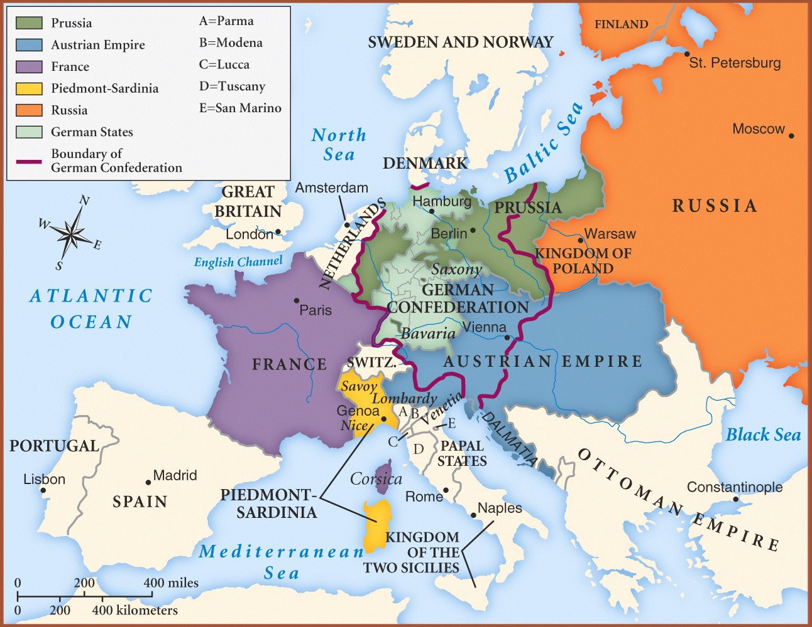

Slide 26
Nationalism
Nationalism – A belief that one’s greatest loyalty should not be to a king or an empire but to a nation of people who share a common culture and history.
Nation-State: When that nation also has its own independent government

Slide 27
France
The Bourbon Monarch returns
Louis XVIII is new king (1815-1824)
Weak, inefficient
Tried to please both political extremes (unsuccessful)
Charles X (1824-1830)
VERY conservative and oppressive
1830 – Rebellions begin, Charles flees
Louis Philippe (1830-1848)
Not really a “Citizen King”
Favored the wealthy
Endured many protests

Slide 28
Revolution Spreads
Germany (1819)
Austria (Metternich) dominates German Confederation
Nationalism movements – students protest
1819 – Carlsbad Decrees limit press, organizing, academic freedom
Belgium (1830)
Congress of Vienna placed Belgium under Dutch rule
Belgians riot for independence, Belgium established in 1839
Leopold I new king
Poland (1830)
Congress of Vienna place under Russian rule with some self-governing powers: “Congress Polan”
Unsuccessfully rebel for independence
Italy (1830)
Divided by Congress of Vienna (Bourbon, papal, Austrian rule)
Revolutions in 1820-21 suppressed
Mazzini leads revolution in 1830
founds “Young Italy” (political group pushing for unification)

Slide 29
1848: Revolutionary Year
New round of revolutions in Europe
(Political and social pressures across Europe at an all-time high…)
-France
-Germany
-Italy
-Hapsburgs (Hungary)

Slide 30
France’s 2nd Republic
Feb 1848 – Paris erupts in violence
Provisional government set up
Universal manhood suffrage proclaimed
Louis Philippe flees
Second Republic (1848-1851)
Gov’t soon splits to moderates v. radicals
Moderates want existing social order
Radicals want social and economic revolution
Radicals create national workshop program set up to guarantee employment for all – fails
“June Days” – workers rebel, soon crushed
1851 - France returns to Empire

Slide 31
Germany
French riots influence German Confederation
Rebellion breaks out
Prussian King – Frederick William IV promises constitutional government and civil rights
Frankfort Assembly (1848)
Meeting of German states, Austria, Bohemia
Issues: Unify Germany? Who leads Germany?
Creates “Declaration of the rights of the German people”
Constitution approved
King William refuses the crown, movement dissolves

Slide 32
Italy
Inspired by French and German revolts
Rebellion breaks out in Northern Italy
King Charles Albert promises new constitution
Influences other Italian states
Austria retakes Northern Italy
Papacy – Pope Pius IX had begun reforms
Pius refuses to help fight off Austria
Counter to unification
Forced to flee
Mazzini takes over and declares a Roman Republic
France sends in an army to defeat Mazzini
Pius returns

Slide 33
The Habsburgs
Reformers in Habsburg lands influenced by revolutions (Hungary especially)
Lajos Kossuth (nationalistic liberal politician)
Demands parliamentary government
Students join Kossuth’s cause – rebellion starts
Metternich forced to resign
New Hungarian constitution
Political division weakens movement
Austrians crush Hungarian independence movement
Kossuth flees

Slide 34
After 1848
Two responses to the failed revolutions of 1848:
“Realpolitik”
Machiavellian notion
The ends justify the means
Do whatever necessary to strengthen your nation
Germany, Italy, France
Reform
Efforts to change political structure and governments to fit the changing times and movements
Britain, Russia, Austria-Hungary

Slide 35
Latin American Society
Social Division based on place of birth:
Peninsulares: men who had been born in Spain
Role: Could hold high offices in government
Creoles: Spaniards born in Latin America
Role: could not hold high office but could be army officers
Mestizos: persons of mixed European and Indian ancestry
Mulattos: persons of mixed European and African ancestry
Indians: provided little economic value to the Spaniards
WHO IS MOST LIKELY TO LEAD
INDEPENDENCE MOVEMENTS?

Slide 36
Napoleon Invasion of Spain 1808
Napoleon put his brother on the throne
Creoles might support a Spanish king but NOT a French one
Creole rebellion begins to break out in Spanish colonies in 1810
Napoleon is gone in 1814 – Powerful armies can be defeated
Creoles Charge Forward!

Slide 37
Libertadores: Bolivar & San Martin
Simon Bolivar
Wealthy Venezuelan creole
Won independence for Venezuela in 1821
Took over command of Martin’s forces and won independence for Peru
Jose de San Martin
Born in Argentina
Won independence for Chile and Argentina
Helped by Bernardo O’Higgins
Mexico – Freedom from Spain
Padre Miguel Hidalgo
Grito de Dolores
Spanish army and creoles defeated him in 1811
Padre Jose Morelos
Led revolution for four years but defeated in 1815 by a creole officer
Augustin de Iturbide
A creole officer who finally declared Mexican independence from Spain in 1821

Slide 38
Brazil – Freedom from Portugal
1807-1815 years of independence
1815 monarch restored in Portugal wanted Brazil as a colony again
1822 Peaceful Independence
Brazilians called for the son of the Portuguese king to rule
Bloodless Revolution
Haiti- Freedom from the French
Toussaint L’Ouverture
An ex-slave - Slaves realized there was power in numbers
Freed the slaves in 1802
Sent to prison and died April 1803
Independence continued and completed by Jean-Jacques Dessalines in 1804

Slide 39
Impact of Independence
Wars disrupted trade
Devastated cities and countryside
Dream of a united Latin America fell apart
Split into several republics:
Columbia, Ecuador, Venezuela, El Salvador, Nicaragua, Costa Rica, Guatemala, Honduras

